Slide 1
Python Class
(Objects, Methods, Inheritance)
Notes:
Pandas is an open-source framework in Python to works with tabular data (rows and columns). pandas have DataFrame which is a two-dimensional data table and Series one dimensional. pandas will help you to explore, clean, and process your data in easy steps

Slide 2
Class and Object
We have been using built-in (primitive) data type and data structure provided by Python
Examples: integer, string, list, dict etc
together with their built-in methods
e.g. string.upper(), list.insert()
Python Class and Object will allow us
to define our own custom data structure
to define custom methods
to reuse and share code
(Class is used in PyTorch ML framework)
Aside: Class, Object and Inheritance are also the main concepts used in object-oriented programming (OOP)
Notes:
Many of the data structures encounter in the remainder of this book are abstract data types—they’re pieces of code that are written on top of other built-in data structures.

Slide 3
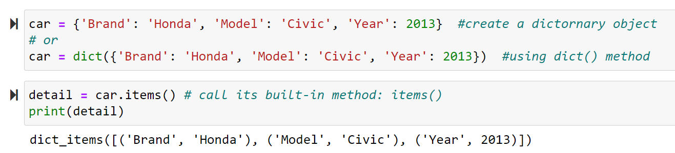
Class
A class is the ‘blueprint’ that we can use to create individual objects.
This is similar to Dictionary data structure (pre-defined in Python) is the blueprint that we can use to create dictionary objects
Recap:
Notes:
# Creating an empty Dictionary
Dict = {}
print("Empty Dictionary: ")
print(Dict)
# Creating a Dictionary with dict() method
Dict = dict({1: 'Geeks', 2: 'For', 3: 'Geeks'})
print("\nDictionary with the use of dict(): ")
print(Dict)
# Creating a Dictionary
# with each item as a Pair
Dict = dict([(1, 'Geeks'), (2, 'For')])
print("\nDictionary with each item as a pair: ")
print(Dict)

Slide 4

Python’s Class
In Python, to create our own custom object in Python
first define a class name Car (use a leading upper case)
using the keyword class
and define the _ _init_ _() method* (also known as a ‘dunder’ method – see later)
that will be automatically called to initialize the individual object when one is newly created
The first parameter in _ _init_ _() is always self
which will be used to refer to the object (instance) when it is created
but typical we will also include other parameters in _ _init_ _()
(*method = function that is applicable to a specific class)
Notes:
WE capitalize the first letter of the class defined

Slide 5
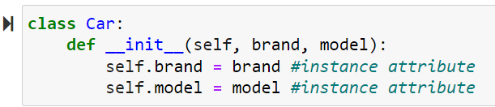
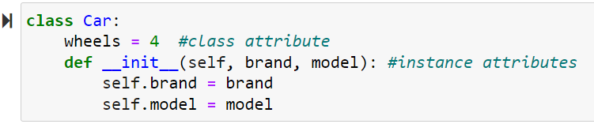
Attributes
We then add brand and model
which are known as Instance attributes
Attribute that is common to all instances
is called the Class attribute

Slide 6
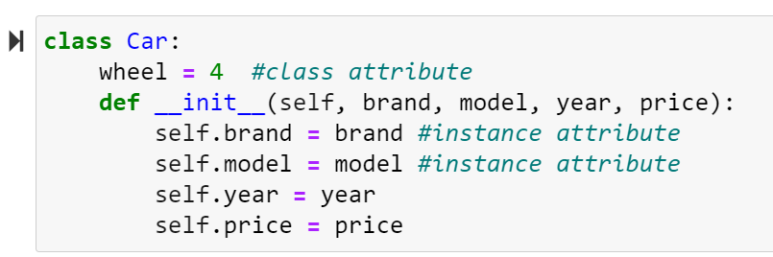

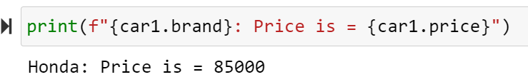
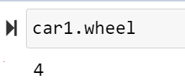
Object and Class Instance
We can then create an object based on the class that we have defined
which are also known as a class instance

Slide 7
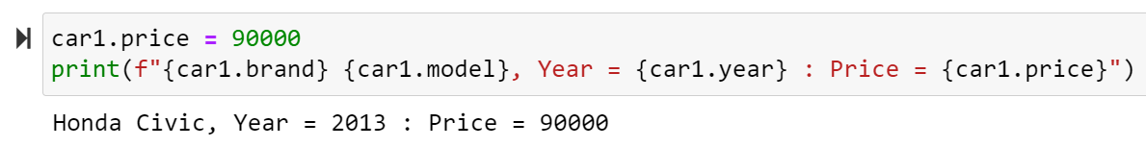
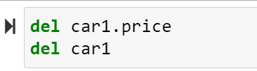
Modifying an Instance
We can change the attribute of an instance:
We can delete the instance’s attribute, and the instance itself using the del keyword:

Slide 8
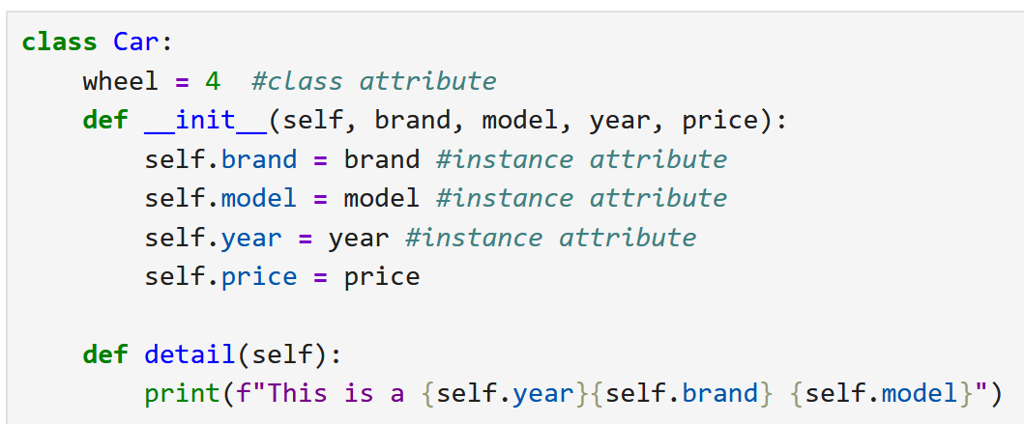

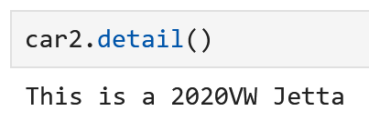
Adding Custom Method
We can add function, but is known as method in the class that can only be used by the object/instance created:
Note the way method is ‘called’
it is ‘attached’ to the object with a dot

Slide 9
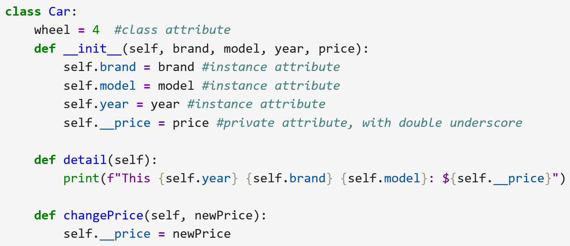

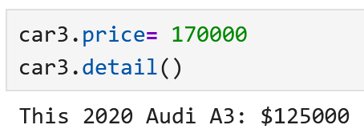
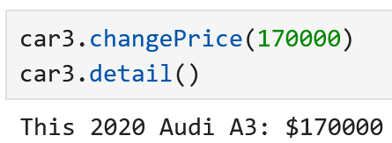
Private Attribute
We can ‘protect’ the data inside an object (using Encapsulation concept)
keep certain details internal (private) : private attribute
allowing only controlled access to them through custom method
Notes:
restricts direct access to an object's internal state, promoting controlled interaction through defined interfaces.
This ensures that price is not accidentally modified in a way that could cause issues.
https://www.freecodecamp.org/news/object-oriented-programming-in-python-interview-questions/

Slide 10
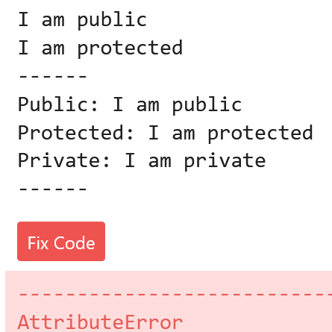
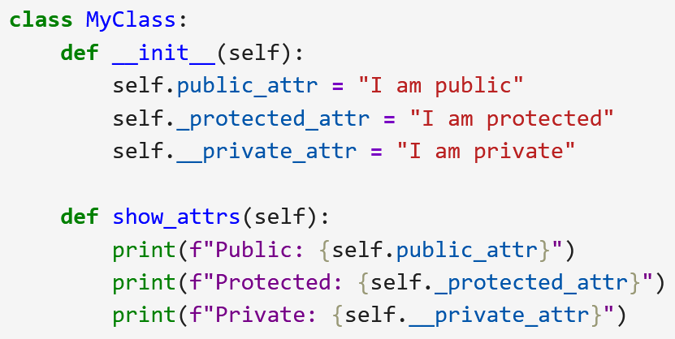
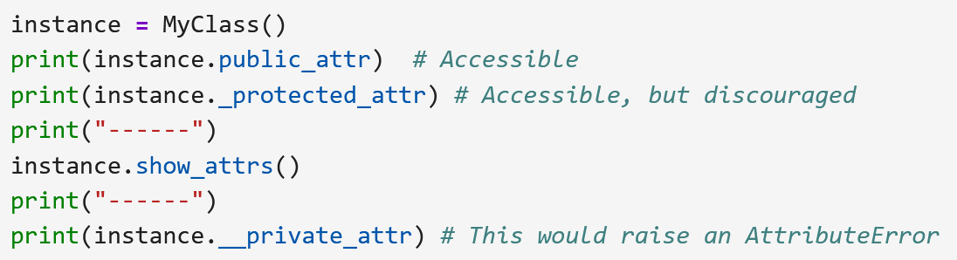
Aside: Private vs Protected
You may come across private attribute that uses single leading underscore
this is also known as Protected attribute
which can still be accessed directly
but mean to discourage from direct access (e.g., may change later)
Finger Exercise:
Notes:
Double Leading Underscore (__variable_name):
This triggers Python's name mangling mechanism.
When an instance variable is prefixed with a double underscore, Python automatically renames it internally to _ClassName__variable_name (where ClassName is the name of the class).
This makes it harder, but not impossible, to access the variable directly from outside the class, as you would need to know the mangled name. It's primarily used to prevent naming conflicts in subclasses.
E.g. print(instance._MyClass__private_sttr) # Accessible via name mangling (discouraged)

Slide 11
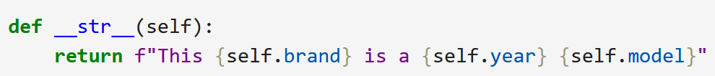
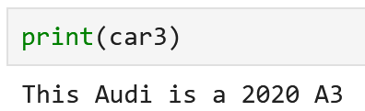
Aside: Dunder Methods
dunder means ‘double underscore’
dunder methods are methods that start and end with _ _
also known as magic methods
_ _init_ _() is a dunder method
used to initialize the attributes of an object when one is newly created
magic method also allows us to use Python’s built-in operations in our class
but redefine in our own way
Examples:
_ _str_ _ method will be called
when we use the print() function
arithmetic methods such as _ _add_ _ and _ _sub_ _ will be called when
we use the arithmetic operation ‘+’ and ‘-’ for the objects in our code
Notes:
WE capitalize the first letter of the class defined

Slide 12
Finger Exercise: _ _add_ _ magic method
Define an _ _add_ _ magic method that will be called when we use the ‘+’ in our code
class Vector:
def __init__(self, x, y):
self.x = x
self.y = y
def __add__(self, other): #add two vectors: self and other
return Vector(self.x + other.x, self.y + other.y)
def __str__(self):
return f"Vector({self.x}, {self.y})"
# Usage example
v1 = Vector(1, 2)
v2 = Vector(3, 4)
result = v1 + v2
print(result) # Output: Vector(4, 6)
Notes:
Explanation:
Vector Class: This class represents a 2D vector with x and y coordinates.
__init__(self, x, y): The constructor initializes the x and y attributes of a Vector object.
__add__(self, other):
This "magic method" is called when the + operator is used with a Vector object.
self refers to the Vector object on the left side of the + operator (e.g., v1 in v1 + v2).
other refers to the object on the right side of the + operator (e.g., v2 in v1 + v2).

Slide 13
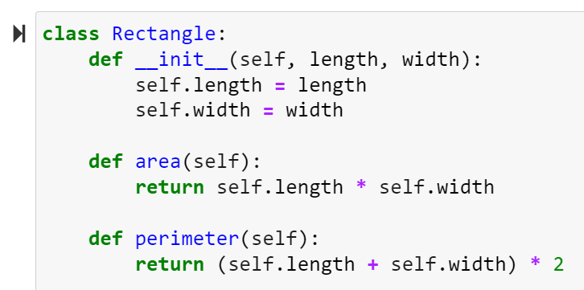
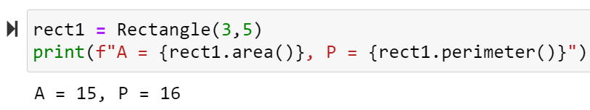
Class Abstraction
Abstraction allows us to show only the important information provided by a class
while hiding the complex parts that the user doesn't need to see/know.
Example: A Rectangle class
i.e. we don’t need to know how the two methods, area() and perimeter(), are computed when calling them
Notes:
Abstraction allows you to show only the important details of an object or system, while hiding the complex parts that the user doesn't need to see.

Slide 14
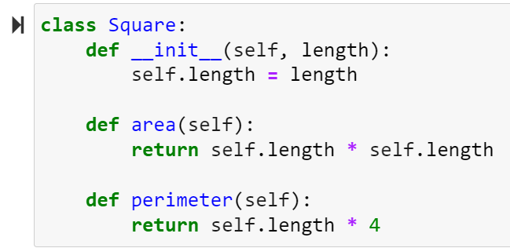
Class Inheritance
Class inheritance enables us to share/reuse code among classes that have certain commonality
Example: A Square class
Calculations used by the Square class are similar to the Rectangle class
with width = length for the Square class
Notes:
Abstraction allows you to show only the important details of an object or system, while hiding the complex parts that the user doesn't need to see.

Slide 15
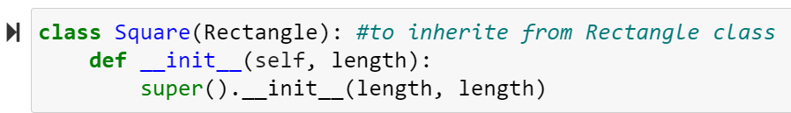
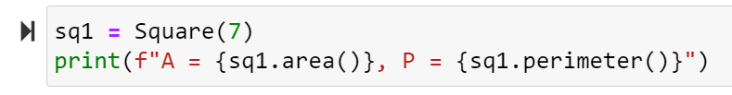
Class Inheritance – Superclass
The Square class can use the code of Rectangle class by inheriting the properties of the Rectangle class - known as the Superclass
using the keyword super
Inheritance hence allows the Square class (known as the Subclass) to acquire the properties of the Rectangle Superclass

Slide 16
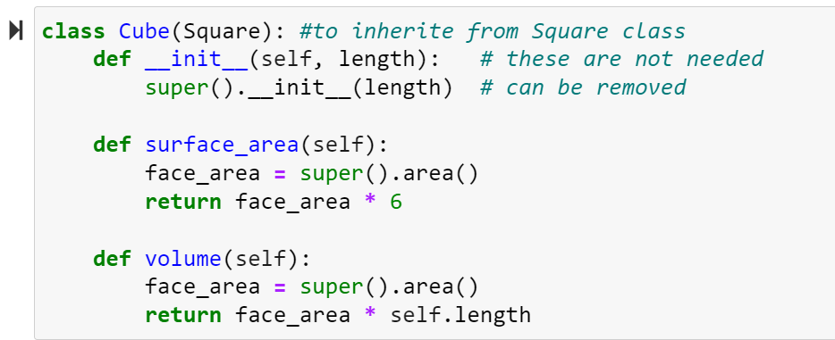
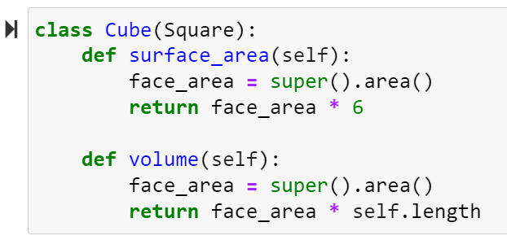
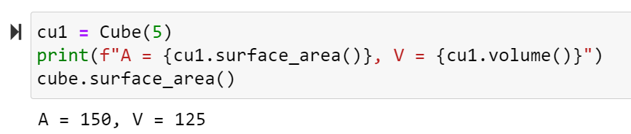
Class Inheritance – Subclass
Inheritance can be further extended to another class from the Subclass

Slide 17
Summary
Class provides a blueprint to create objects known as instances of the class
Instance attributes are the variables used by the instances
Class attributes are attributes common to all instances
The function define within a class is known as method
Private attributes are attributes that are intended for internal use within the class (accessible through its method)
Class Abstraction allows you to focus on its interface (and hide its internal)
Class inheritance allows a class, the Superclass, to provide a blueprint for common behavior that can be shared among other classes known as the subclasses
Class inheritance can be further extended to another class from the subclass

Slide 18
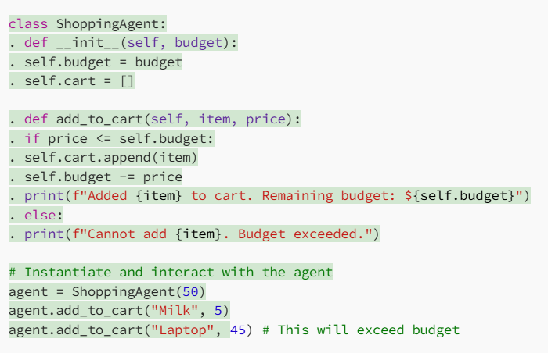
Hands-on Exercise
class ShoppingAgent:
def __init__(self, budget):
self.budget = budget
self.cart = []
def add_to_cart(self, item, price):
if price <= self.budget:
self.cart.append(item)
self.budget -= price
print(f"Added {item} to cart. Remaining budget: ${self.budget}")
else:
print(f"Cannot add {item}. Budget exceeded.")
# Instantiate and interact with the agent
agent = ShoppingAgent(50)
agent.add_to_cart("Milk", 5)
agent.add_to_cart("Laptop", 45) # This will exceed budget
Notes:
Abstraction allows you to show only the important details of an object or system, while hiding the complex parts that the user doesn't need to see.

